Slide 1
New Dermatology Curriculum 2021
Dr Sarah Cockayne
Curriculum Lead SAC
No conflicts of interest
At request BAD-please do not record or photograph these slides!

Slide 2
Overview
Definition curriculum
Resources on JRCPTB & BAD websites
New curriculum/ changes cf old curriculum
Transitioning

Slide 3
Definition curriculum
Previously confusing - portfolio called competencies ‘Curriculum’
Derived from ‘racecourse’ = overall guideline that describes subjects/ concepts that need to be taught or learnt (syllabus), how to teach them & process of assessment to show each student has learnt what they need to
New portfolio still has tab for curriculum but drop down labelled as ‘Specialist training…….Capabilities in Practice’ to reduce confusion

Slide 4
Resources on JRCPTB & BAD websites
JRCPTB
Curriculum
Rough Guide
Syllabus
ARCP decision aid (found in Rough guide but currently not on JRCPTB website otherwise)
Mapping document
BAD
Transitioning guide

Slide 5
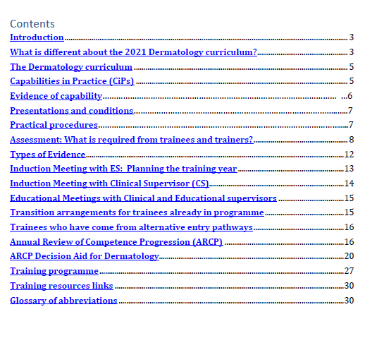

Slide 6
Rough guide- Training programme
As before, curriculum has guidance on no. clinics & nos. seen
IN ADDITION in Rough Guide -minimum time spent training in:
skin cancer clinics (nos may be reduced if virtual or remote consults)
contact
paeds
surgery

Slide 7
New curriculum

Slide 8
Aims for new curriculum
Flexibility/ Generalism- trainees who can safely manage full range skin conditions presenting to a general consultant dermatologist. Can work in any hospital in the country
MRCP standard-wanted to retain general medical background
Service delivery- workforce challenges (200 unfilled cons posts) & increased burden skin disease. Need ability to plan/ provide different models of care eg manage team of nurses, GPwERs, PAs etc to deliver services in hospital or community
Professional advances- biologics, teledermatology

Slide 9
Overview Dermatology curriculum changes for 2021
UNCHANGED | Appraisal, basic assessments/ evidence & ARCP process Supervision, feedback | (New ARCP decision aid presented differently)
CHANGED | Entry into training | Group 2 MRCS added
 | Syllabus | Replaced by list of presentations, with supplementary syllabus guidance on JRCPTB website
 | Competencies | Replaced by Capabilities in Practice (CiPs). Emphasise medical complexity. Biologics, telederm added.
 | Assessment | ES scores CiPs for ARCP each year
 | Evidence | Annual MSF Optional ACAT added Non-surgical DOPs: 5 now ‘essential’ & new procedures eg dermoscopy/ taking telederm images Surgical DOPs: 1 flap essential at level of supervised practice. All surgical DOPs now signed off by defined year of training
 | Training Programme | Acute dermatology expectations Numbers seen in clinic

Slide 10
Changes 1. Entry into training

Slide 11
Entry into training
Entry into Specialty Medical training-Groups 1 and 2 from 2019 (Shape of training)
GROUP 1–most specialties 3 yrs Internal Medicine stage 1 training, then specialise. Dual accredit medicine & specialty to deliver more general medical care
GROUP 2-Dermatology sits within this group. Single accreditation in Dermatology only, with 2 years stage 1 internal medicine prior to entry
Qualifications prior to entry
MRCP and MRCPCH were previous routes of entry & are retained
MRCS has been added following advice from Shape of Training panel (WITH medical experience)

Slide 12
MRCPCH and MRCS entry criteria -medical experience
Satisfactory completion 3 yrs level 1 paediatrics with full MRCPCH or 2 yrs Core Surgical Training with full MRCS plus ‘either’ of
IMY2 capabilities
12 months’ experience medical specialties admitting acutely unwell medical patients, managing their immediate follow up

Slide 13
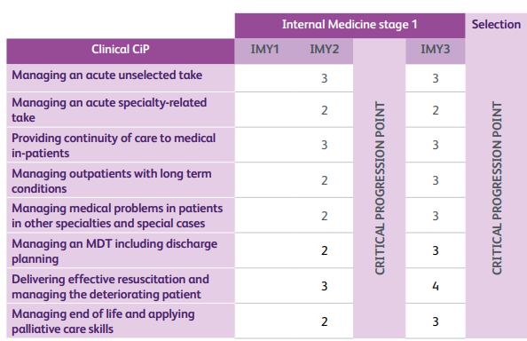
Notes:
Level 3 is with supervisor off site-up to med reg level
Level 2 is with supervisor on site
This is what we wanted prior to starting derm and we are not expecting to keep up to that level once trainees

Slide 14
Changes 2.Syllabus

Slide 15
Syllabus/ detailed competencies
p11-73 old curriculum removed. Instead-3 page list of presentations and conditions
Separate syllabus document on JRCPTB website with JRCPTB branding, controlled by SAC. Co-badged with the BAD logo alongside JRCPTB but SAC has ownership
Allows SAC (with BAD input) to edit the syllabus to keep up to date, without having to submit to the GMC-flexibility
Will be syllabus for SCE

Slide 16
List of 11 presentations & conditions to appear in curriculum-example
System/specialty and subspecialty | Presentations | Conditions/ issues
Connective tissue disease | Lupus erythematosus, dermatomyositis, mixed connective tissue disease, vasculitis, panniculitis, morphoea | Aetiology and natural history Cutaneous and non-cutaneous presentations Assessment and diagnostic tools Dermatopathological correlation Dermatological therapeutics Psychosocial impact Associated co-morbidities Triage and prioritisation Need for multi-specialty/multi-professional liaison
Cutaneous allergy and urticaria | Acute and life-threatening drug eruptions, contact and occupational dermatitis, urticaria, angioedema | Aetiology and natural history Cutaneous and non-cutaneous presentations Assessment and diagnostic tools Dermatopathological correlation Dermatological therapeutics Psychosocial impact Associated co-morbidities Triage and prioritisation Need for multi-specialty/multi-professional liaison
Immunobullous disease | Bullous pemphigoid, pemphigus vulgaris, other bullous dermatoses | Aetiology and natural history Cutaneous and non-cutaneous presentations Assessment and diagnostic tools Dermatopathological correlation Dermatological therapeutics Psychosocial impact Associated co-morbidities Triage and prioritisation Need for multi-specialty/multi-professional liaison

Slide 17
Changes 3. Capabilities in Practice
New assessment method replacing competency sign off

Slide 18
13 capabilities in practice in new Dermatology curriculum
Six Generic Internal Medicine CiPs (assessed globally)
Seven Dermatology CiPs (assessed with level indicator)

Slide 19
Changes 4. Assessment change for ES
CiP scoring
Notes:
Niall going to cover this

Slide 20
Generic CiP assessment is global. Will be done each year for the 6 CiPs as part of ES report
Below expectations for this year of training | May not meet the requirements for critical progression point
Meeting expectations for this year of training | Expected to progress to next stage of training
Above expectations for this year of training | Expected to progress to next stage of training

Slide 21
Specialty CiP assessment- also marked each year as part of ES report
Level | Descriptor
1 | Entrusted to observe only – no provision of clinical care
2 | Entrusted to act with direct supervision: the trainee may provide clinical care, but the supervising physician is physically within the hospital or other site of patient care and is immediately available if required to provide direct bedside supervision
3 | Entrusted to act with indirect supervision: the trainee may provide clinical care when the supervising physician is not physically present within the hospital or other site of patient care, but is available by means of telephone and/or electronic media to provide advice, and can attend at the bedside if required to provide direct supervision
4 | Entrusted to act unsupervised

Slide 22
Changes 5.Evidence

Slide 23
Changes to Evidence
Acute care assessment tool (used to assess on call in IM) now added as OPTIONAL
Wanted assessment OPD session & feed back on how to plan and run a clinic efficiently. Or assessment on call of ability to triage and prioritise patients. (Aim to develop an OPAT ie outpatient assessment tool)
Outpatient care assessment tool (OPCAT) subsequently arrived eportfolio & could also be used but is about patient centred care, communication etc rather than running/ managing OPD.

Slide 24
Changes to evidence
MSFs
GMC require annual MSF for all specialties
Surgical DOPs
All surgical DOPs now signed off by defined year of training
I small flap essential to level of supervised practice, to enable understanding of techniques involved
Non surgical DOPs
5 now ‘essential’
New procedures added on dermoscopy and telederm added

Slide 25
Changes 6&7. ARCP decision aid and Training programme

Slide 26
Changes to Training programme
Acute dermatology- curriculum now states dermatology on call does not have to be out of hours rather than all trainees must have out of hours commitment
Numbers expected to see in clinic by end of training has changed to BAD guidance of 13-16 patients in a general clinic with a ratio of 1 new: 1.6 follow up, eg 5 new and 8 review patients (cf old 6 new and 12 review patients)

Slide 27
Transitioning
GMC require all transfer to new curriculum Aug 2021, except within 12 training months of completion
NB if any trainees not on new curriculum on eportfolio yet, ES must ask trainee to send details to JRCPTB at :
curriculum@jrcptb.org.uk
to register them
Must specify that are Dermatology trainees
Notes:
Different to what I said last time

Slide 28
Transitioning documents for trainees/ trainers
Look on JRCPTB website for
Dermatology 2021 CiPs mapping to previous curriculum competencies document
Rough Guide (which contains new ARCP decision aid and level indicators)
Look on BAD website for
Transitioning guide (Education -> Derm spec trainees-> Curriculum)
NB Link to Academy of Medical Royal Colleges transition document in Rough Guide not v helpful

Slide 29
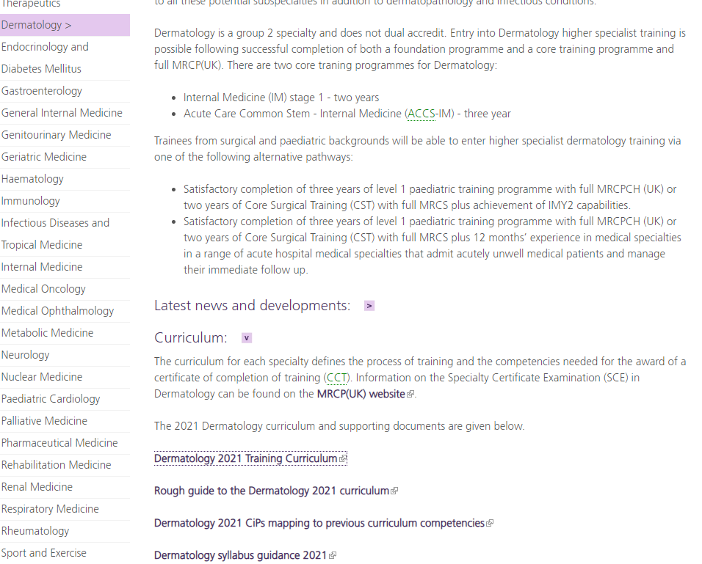
Transitioning documents

Slide 30
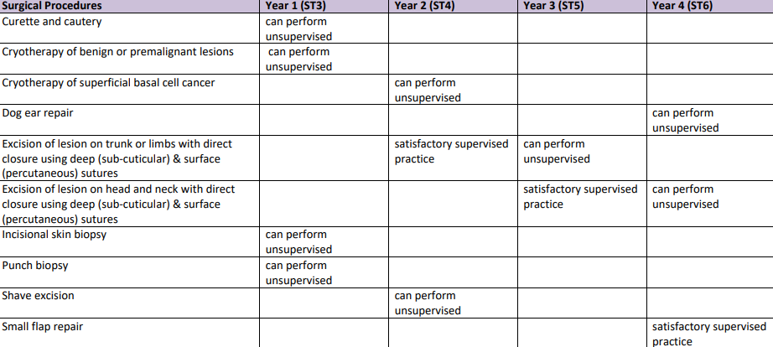
Transitioning for trainees
1. In ARCP decision aid pg 20 in Rough guide, look at level CiPs & procedures required eg if ST4 now, need new levels for ST3 which are:
generic CiPs -meets expectations for all (or above)
Specialty CiPs - level 2 for all (or above)
Procedures- punch, incisional biopsy, C and C and cryo of benign lesions etc

Slide 31
Transitioning for trainees
Rate selves on these on portfolio, using evidence from old competencies and mapping guide. Could summarise in PDP.
NOT expected to relink evidence
Mapping old curriculum to new specialty CiPs will be hardest- look at existing evidence.
Work out if anything to be rectified during year to bring to required level. Get that information ready for ES.
Notes:
not failed your ST3 year because you now do not have something that you need, but just need to have it in place for the next ARCP

Slide 32
Transitioning for trainers
Need to review
Dermatology 2021 CiPs mapping to previous curriculum competencies document
Rough Guide (which contains new ARCP decision aid and level indicators)
At induction meeting agree &
Rate CiPs on portfolio using evidence from competencies so far
Record of gap analysis and transfer to new curriculum which will set objectives for aspects curriculum need to focus on eg procedures

Slide 33
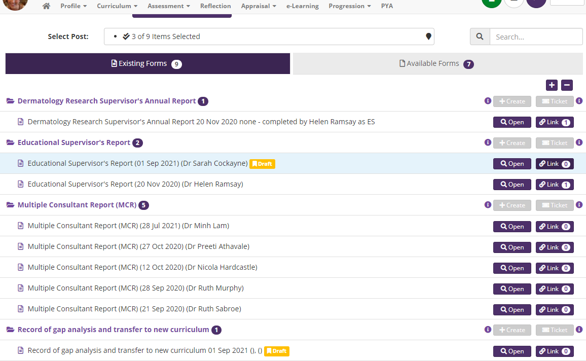

Slide 34
Summary Dermatology curriculum changes for 2021
UNCHANGED | Appraisal, basic assessments/ evidence & ARCP process Supervision, feedback | (New ARCP decision aid presented differently)
CHANGED | Entry into training | Group 2 MRCS added
 | Syllabus | Replaced by list of presentations, with supplementary syllabus guidance on JRCPTB website
 | Competencies | Replaced by Capabilities in Practice (CiPs). Emphasise medical complexity. Biologics, telederm added.
 | Assessment | ES scores CiPs for ARCP each year
 | Evidence | Annual MSF Optional ACAT added Non-surgical DOPs: 5 now ‘essential’ & new procedures eg dermoscopy/ taking telederm images Surgical DOPs: 1 flap essential at level of supervised practice. All surgical DOPs now signed off by defined year of training
 | Training Programme | Acute dermatology expectations Numbers seen in clinic

Slide 35
Resources on JRCPTB & BAD websites
JRCPTB
Curriculum
Rough Guide
Syllabus
ARCP decision aid
Mapping document
BAD
Transitioning guide

