Slide 1
B.A.D. Syllabus Guidance
STC Chairs, TPDs & Clinical Tutors’ and Educational Update for Trainers Annual Meeting
13 September 2021
Mabs Chowdhury FRCP FAcadMed

Slide 2
Declarations
Clinical Lead for Dermatology e-learning for Health
CONFIDENTIAL: IT IS STRICTLY FORBIDDEN TO RECORD/PHOTOGRAPH ANY PART OF THIS PRESENTATION

Slide 3
Excellence by Design principles

Slide 4
B.A.D. Syllabus Guidance: Main Aims
Detailed guidance for trainees and educational supervisors
Knowledge, skills and behaviours for higher standard of whole dermatology practice required for consultants
Learning methods e.g. specialist clinics, e-learning for health, courses
Linked with JRCPTB Dermatology Curriculum August 2021

Slide 5
Use in Partnership to support trainees and trainers
GMC & JRCPTB Curriculum
JRCPTB & BAD
Syllabus Guidance

Slide 6
Changes from previous syllabus
Updated all generic and modular syllabus sections
New sections:
Teledermatology, Dermoscopy, Skin of Colour, Hair and Nails
Global Health, Lymphoedema, Management & Leadership
Expansion of sections:
Medical Dermatology: acne, psoriasis, atopic eczema, lichenoid and CT diseases
Skin cancer, Paediatrics
Removed section:
Medicolegal reports (moved to post-CCT fellowship)

Slide 7
B.A.D. Education Subcommittee
Re-established 2016 to write syllabus
Twice yearly meetings
Chaired by B.A.D. Academic Vice President
Ruth Murphy: 2016-2017
Mabs Chowdhury: 2017-2019
George Millington: 2019-2021
Stakeholder input & feedback: SIGs/Trainees
SAC Chair: Tamara Griffiths
liaise with Sarah Cockayne (SAC Curriculum Lead)

Slide 8
Committee Members 2017-2019
Hazel Bell Mabs Chowdhury Carolyn Charman Stuart Cohen David de Berker Giles Dunnill Sara Edward Tamara Griffiths Manjit Kaur John Lear Raj Mallipeddi Sacha Marsland Edel O’Toole Lesley Rhodes Jean Ayer (co-opted member) Amr Salam Jane Setterfield Manu Shah Jennifer Sharif Lindsay Shaw Siu Tsang | Vulval Disease Cutaneous allergy and SCE Teledermatology and Community Dermatology Secondary Care Dermatology/e-learning IT/Teledermatology Medical Dermatology Dermatopathology Cosmetic Dermatology/SAC Chair Hair and Nail Diseases Skin Cancer Advanced Dermatology Surgery/Laser Urticaria Research/Genomics Photodermatology Photodermatology Trainee Representative Oral Dermatology Male Genital Disease Medical Dermatology Paediatric Dermatology B.A.D. Academic Administrator

Slide 9
Syllabus development

Slide 10
March 2019
Acne (Jennifer Sharif/Giles Dunnill)
Psoriasis
Lichenoid disorders
Connective tissue diseases
Atopic eczema (Carolyn Charman/Lindsay Shaw)
Global Health Dermatology (Claire Fuller)
3 Edited Sections completed
Skin Cancer (John Lear)
Wound Care and Dressings (Girish Patel)
Paediatric Dermatology (Lindsay Shaw)
New Suggested Sections
Management and Leadership (Mabs Chowdhury/Amr Salam)
Dermoscopy

Slide 11
July 2019-2021
New Sections by recently invited experts
Skin of colour (Sharon Belmo)
Dermoscopy (Ausama Atwan)
Lymphoedema (Kristiana Gordon/Peter Mortimer)

Slide 14
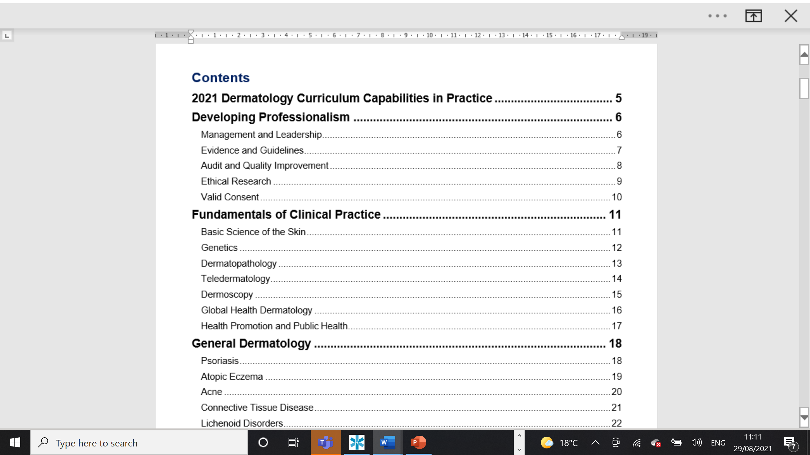

Slide 15
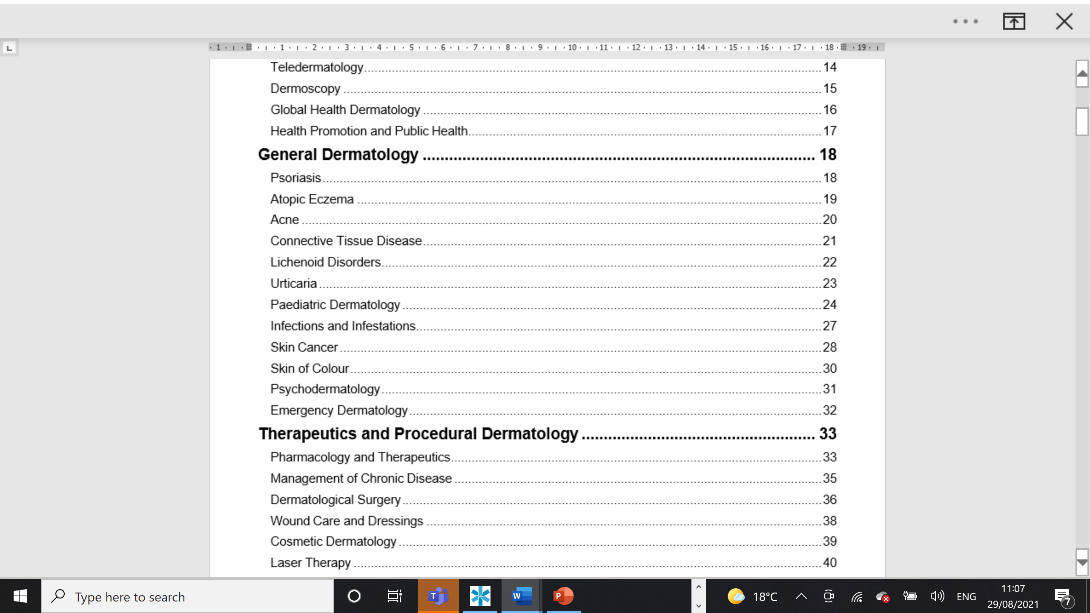

Slide 16
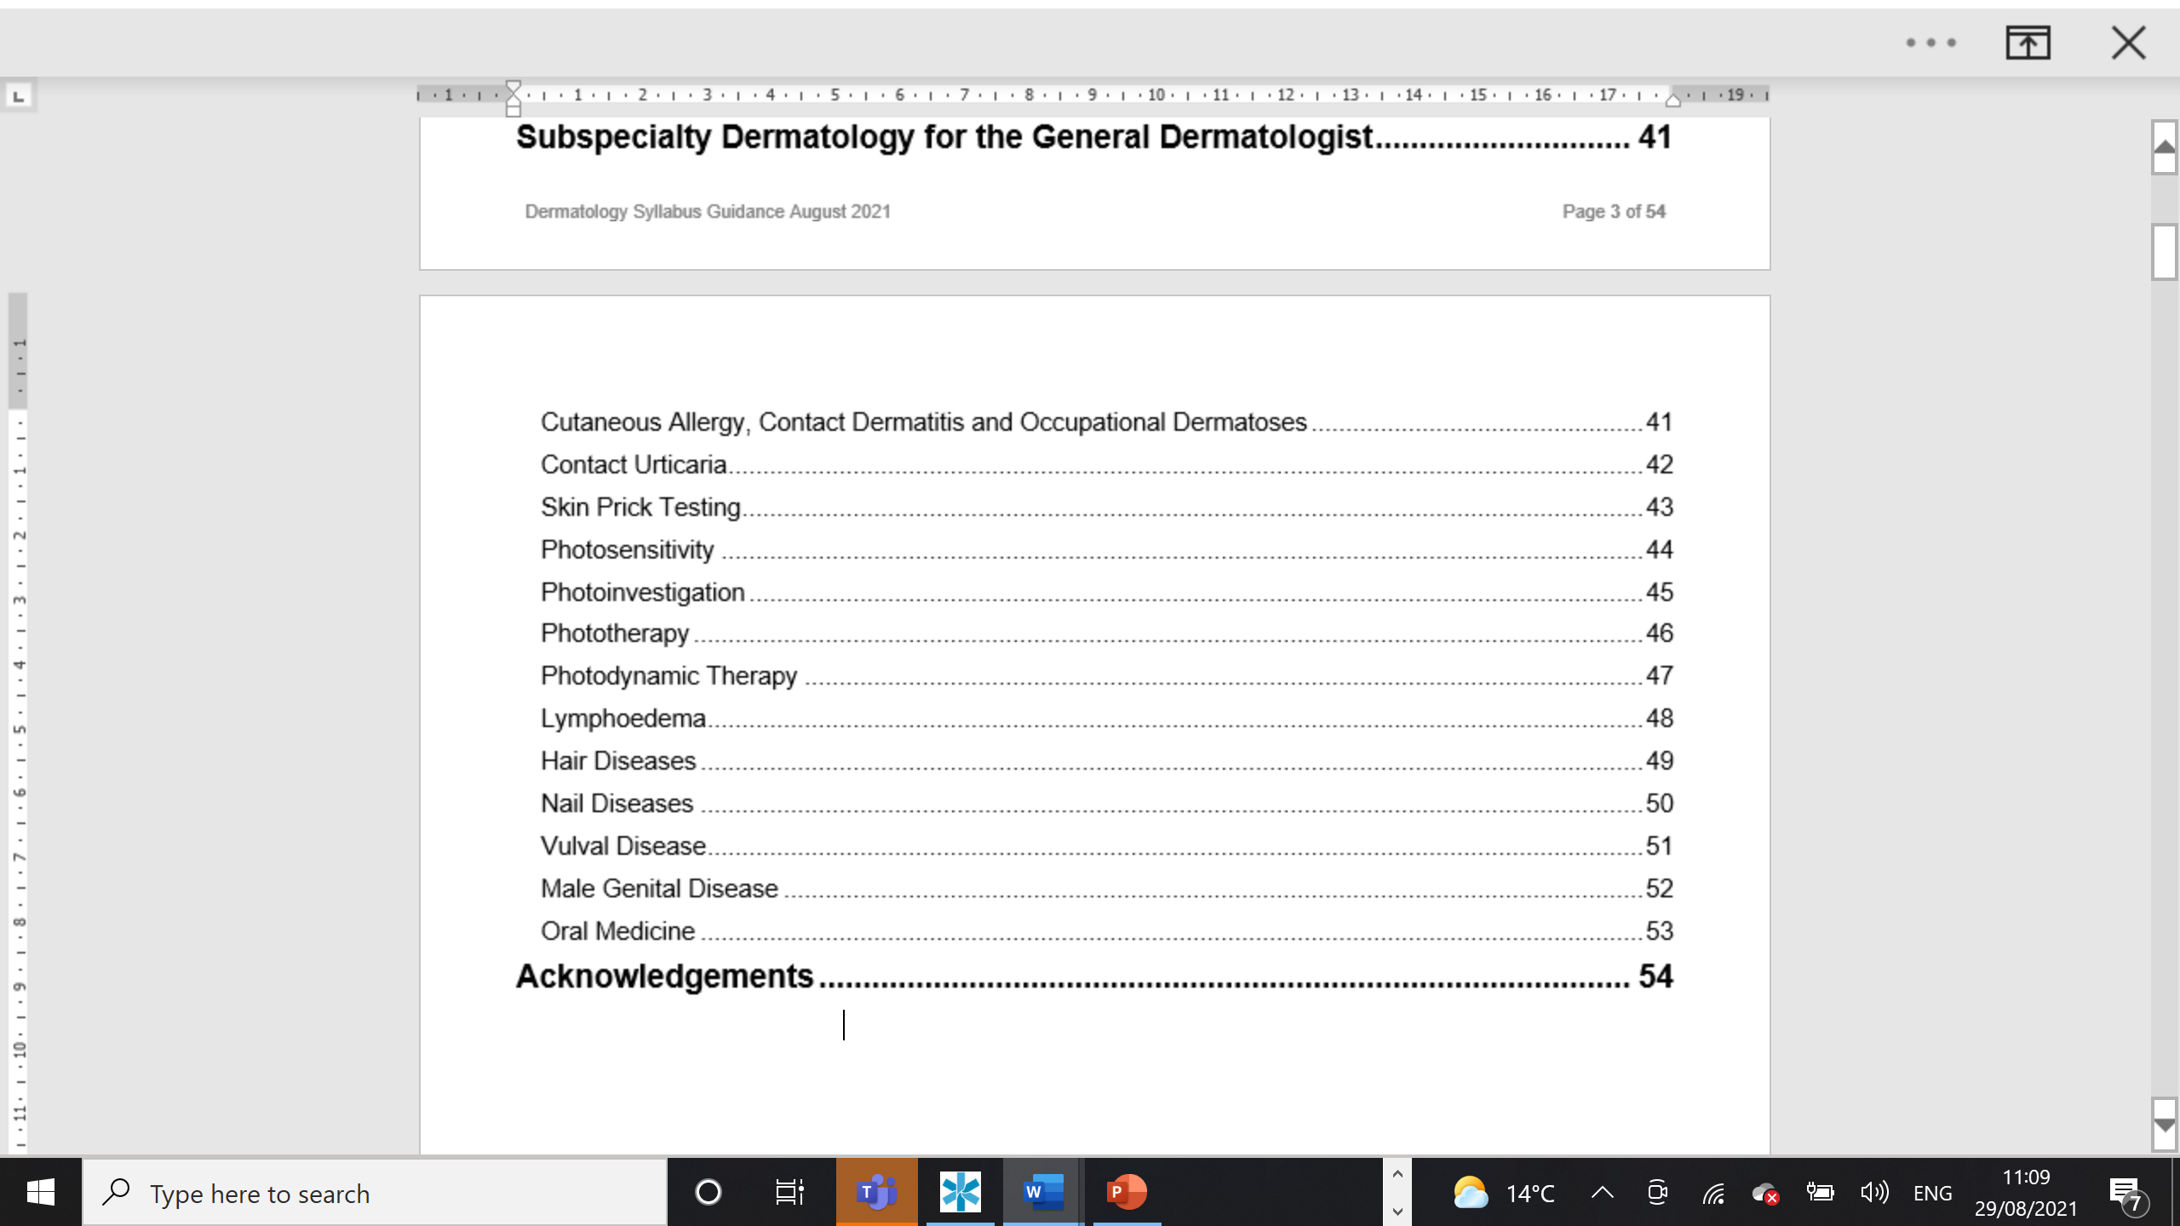

Slide 17
Competency based medical education
☑
Can do it
Informing competencies
Informing competencies
Informing competencies
Informing competencies
Informing competencies
Informing competencies
Informing competencies
Subcompetencies
Subcompetencies
Subcompetencies
Subcompetencies
Subcompetencies
Subcompetencies
Subcompetencies
Subcompetencies
Subcompetencies
Subcompetencies
☑
☑
☑
☑
☑
☑
☑
☑
☑
Knowledge, skills, attitudes
Notes:
☑☑☑☑

Slide 18
Shifting the focus to outcomes
Can do it
Informing competencies
Informing competencies
Informing competencies
Informing competencies
Informing competencies
Informing competencies
Informing competencies
Subcompetencies
Subcompetencies
Subcompetencies
Subcompetencies
Subcompetencies
Subcompetencies
Subcompetencies
Subcompetencies
Subcompetencies
Subcompetencies
☑
EPA CiP
Outcome
Knowledge, skills, attitudes

Slide 19
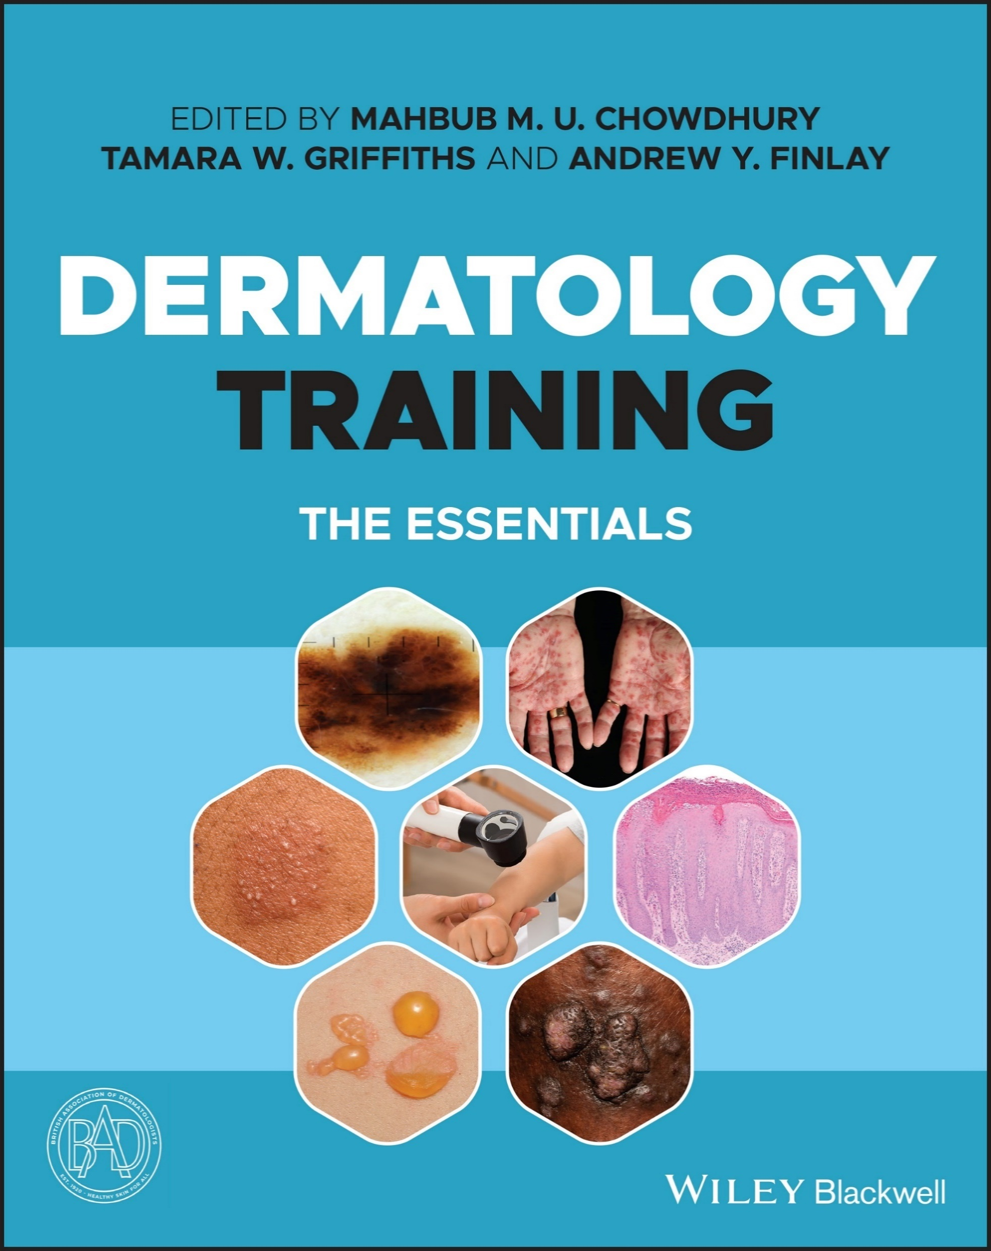
Dermatology Training: the Essentials
B.A.D. Training Textbook mapped to the syllabus for ST3/ST4
Published by Wiley in early 2022; e-book
Editors: MM Chowdhury, TW Griffiths, AY Finlay
Trainee feedback on chapters
Thanks to Expert Authors (pro bono)
Support from excellent B.A.D. Publishing Team
29 chapters
SCE questions for each chapter
Chapters all mapped to CiPs

Slide 20
Dermatology Training: the Essentials Book chapters mapped to CiPs
Chapter no. | Chapter title | Capabilities in Practice
1 | Think critically, research and publish | G5
2 | How to lead and manage in dermatology | G1, G3, G6, S1, S3
3 | Ethical dilemmas in dermatology | G2, G6
4 | Basic science of the skin | G5, S1, S2
5 | Dermatopathology | S1, S2, S4, S7
6 | Teledermatology | S1, S2, S3
7 | Dermoscopy | S1, S3, S4, S7
8 | Clinical measurement methods | G5, S1, S3, S6, S7
9 | Global and public health | G1, G3, G4, S3
10 | Medical dermatology | S1, S2, S3
11 | Paediatric dermatology | S2, S6
12 | Infections and infestations | S1, S2, S3, S6, S7
13 | Skin cancer | G4, S4
14 | Dermatology for skin of colour | S1, S2, S3, S4, S5, S6, S7
15 | Psychodermatology | S1, S2, S3, S6
16 | Emergency dermatology | G3, S2
17 | Topical therapy | S1, S2, S3, S6
18 | Systemic therapy | S1, S2, S7
19 | Skin surgery | G3, S4, S5
20 | Wound care and dressings | S1, S3
21 | Cosmetic dermatology | G1, G2, S5
22 | Laser therapy | G1, G2, S5
23 | Cutaneous allergy | G3, G4, S7
24 | Photosensitivity | G3, S7
25 | Phototherapy | G3, G4, S1, S7
26 | Lymphoedema | G3, S1, S3
27 | Hair and nail diseases | G3, S7
28 | Genital skin diseases | G2, G3, S7
29 | Oral medicine | G3, S7

Slide 21
Conclusions
Huge thank you to all of the dedicated Education Subcommittee members and co-opted authors
Syllabus development
with stakeholder/SIG & expert input/trainee feedback
Capabilities in Practice (CiPs) for assessment
Further syllabus changes via BCD/B.A.D

Slide 22
Any questions?

