Slide 1
National Teledermatology Investment Programme
Shared learning webinar
3 May 2022

Slide 2
This webinar is being recorded.

Slide 3
Welcome
Dr Tanya Bleiker
BAD president & consultant dermatologist, University Hospitals of Derby and Burton

Slide 4
National context
Breid O’Brien
Director of innovation & digital health
Digital Care Models team, NHSEI

Slide 5
Teledermatology in the Midlands Primary & secondary care perspectives
Rozlyn Geary, consultant dermatologist & teledermatology project manager, Walsall Healthcare NHS Trust
Mani Dhesi, transformation director, SDSMyHealthcare
Dr Tracey O’Shea, GPwER in dermatology, SDSMyHealthcare Lisa Janiec, systems support senior manager, outpatients
Sarah Ellis, IT operations director, Dudley Group

Slide 6
Funded projects
NHSX funding bids approved for 5 systems
- Birmingham & Solihull
- Herefordshire & Worcestershire
- Joined Up Care Derbyshire
- Lincolnshire
- The Black Country & West Birmingham
Mixture of new pilots and expansion of existing approaches to teledermatology
Some include suspected skin cancer pathways in scope - BCWB
Various different approaches in place/proposed across the Midlands region - community hubs, training support, use of different suppliers and advice and guidance methods
Challenges identified with delays with procurement, potential for dual processes, staff redeployment, GP time, training and uptake

Slide 7
Shared learning
Collaboration with system leads, NHSEI teams and NHSx to overcome challenges
Webinars
Midlands Teledermatology Share & Learn Part 1 – July 2021
Midlands Referral Optimisation Webinar – showcased dermatology advice & guidance models – Oct 2021
Using digital technology to transform care pathways | The King's Fund (kingsfund.org.uk)
Midlands Teledermatology Share & Learn Part 2 planned for Q3 2022/23
Case studies developed for funded projects and will be published by NHSEI when finalised

Slide 8
Midlands case studies
Community Dermatology Model & Photo Hub – Birmingham & Solihull
Mani Dhesi – transformation director – SDSmyHealthcare
Dr Tracey Oshea – GPwER in dermatology - SDSMyHealthcare
2ww skin cancer teledermatology pathway development – Black Country & West Birmingham
Roz Geary – ICS cancer programme manager
Sarah Ellis - IT operational director, The Dudley Group NHS Foundation Trust

Slide 9
SDS dermatology services

Slide 10
Organisation overview
South Doc Services (SDS) is a GP collaborative in Birmingham that has delivered routine and urgent community services since 1996 (such as the Urgent Treatment Centre)
SDSmyhealthcare is a subsidiary of South Doc Services and supports General Practice in delivery of core objectives and wider transformation work
SDSmyhealthcare support coverage in Birmingham: 67 practices supported 436,000 population coverage 9 Primary Care Networks supported

Slide 11
Our mission
Our mission is to ensure our patients, within the Birmingham population, receive high quality care in the most appropriate setting for their needs.
4 objectives of each piece of transformation work we undertake are to:
Improve clinical results and impact
Improve patient and staff experience
Optimise use of limited resources to reduce costs
Sustainable and scalable delivery models

Slide 12
SDS dermatology service impact
Service launched in Jan 2018 with one GP and one specialist nurse from Oxford. Now up to 9 GPs and 2 specialist nurses
Over last 6 months we have added additional photo clinics at hub locations to support the teledermatology part of our service with support from NHSEI, to recruit additional staff (e.g. HCAs) and buy equipment (e.g. iPads and dermatoscopes)
We now have three routes to exploit ‘teledermatology’ opportunities into our service: from GP practice with patient, patient direct, or our hub photo clinics
The service admin team (trained by our GPs) are able to check if we have appropriate quality from any of these routes to ensure we reduce wasted clinician time

Slide 13
Dermatology - Enhanced Primary Care Service
Clinical Review or Hub Photo Clinic appointment booked by practice via appointment book in Primary Care System that allows holistic review with access to full Medical History
Remote Review in Primary Care using photos from GP/Patient/Hub Photo Clinic for routine referrals e.g. GP with Extended Role, Specialist Nurse
Expert/Specialist advice
Outcome of Review
Onward next step
Patient consultation is required and booked
(Video / Telephone / Face-to-Face)
Primary Care Plan typed directly into Primary Care record
Onward Referral to external Community Service or Secondary Care
Patient case is booked into a Dermatology MDT with Consultant support
Patient is booked for further Hub photos or further diagnostics
Managed by Practice
Managed by Community Trust or Secondary Care
Task sent to practice
A&G request or Referral
Patient is booked into Nurse Sub-Clinic
Managed in Primary Care by Service Delivery Team
©2022 SDSmyhealthcare

Slide 14
SDS dermatology service impact
Service launched in Jan 2018 with 1 GP and 1 specialist nurse from Oxford. Now up to 9 GPs and 2 specialist nurses
Number of appointments first 8 months |  |  |  | 1025 | 52.7% of these patients only required the first initial review of photos and/or notes and were then managed in Primary Care via a with management plan typed into the patient notes by the dermatology expert GP. Onward referral rate to secondary care was less that 10 per cent.
Number of above 1025 appointments were virtual review of photos and notes |  |  |  | 696
Number of above 1025 appointments that were a consultation with patient by video or F2F |  |  |  | 329
Time from referral to 1st review
 |  | <1 week | 437 |  | Over 90% of patients reviewed within 2 weeks for this cohort.
 |  | <2 weeks | 240

Slide 15
SDS dermatology service impact
Upskilling of primary care clinicians through rapid feedback without delay and transfer of learning between consultants and GPs within clinical system
GPs receive advice in real time without any paperwork or delay
Reduced paperwork and time spent completing it, as all done via primary care clinical system.
Rapid access to service: current longest wait is 2 weeks for teledermatology review. Referral rate to secondary care continues to be below 10 per cent

Slide 16
Feedback of dermatology specialist review service
GP feedback:
“The SDS dermatology service has upskilled us in the practice – each patient review becomes a learning opportunity and makes us more aware of conditions to consider and management options available in primary care.
The shared use of EMIS Web means that a single patient record is available, and I feel this reduces risk and friction in communications between colleagues.”

Slide 17
Current developments
Our Dermatology Service has worked in collaboration with both major local acute providers to deliver support to long waiters in dermatology resulting from the pandemic.
Across these two programmes, we have supported over 1,000 patients, who have been waiting for over 2 years for treatment in many instances, due to impact of the pandemic on secondary care capacity.

Slide 18
Teledermatology project Black Country and West Birmingham CCG Roz Geary – teledermatology project manager Sarah Ellis – IT operations director Dudley Group

Slide 19
Contents
Rationale and scope
Project background
System and stakeholders
Teledermatology model
Stage 1: procurement
Teledermatology plan – next steps

Slide 20
“There is now a substantial evidence base that teledermatology is an effective tool for managing the unsustainable demand for secondary care dermatology services. Across the country there are several examples of established, highly effective teledermatology services.
Primary care benefits from rapid specialist opinions and the educational value of immediate feedback. Patients benefit from care closer to home, shorter waiting times and being directed to the most appropriate clinician first time. Secondary care benefits by reducing demand and building relationships with colleagues in primary care”
Dr James Halpern – consultant dermatologist
Clinical skin ICS lead and clinical director of RWT & WHT

Slide 21
1. Rationale
NHS Long Term Plan states that:
A new, faster diagnosis standard which will ensure that patients receive a definitive diagnosis or ruling out of cancer within 28 days will be implemented.
Technology will enable the NHS to redesign clinical pathways. Triaging (and potentially completing) some specialist referrals such as dermatology with photos and questionnaires will allow some patients to be managed entirely digitally.
To speed up cancer diagnosis and support our ambitions to achieve earlier diagnosis, with improved patient experience, for all patients with cancer symptoms or suspicious results will be implemented.
Scope
All dermatology referrals on the 2WW cancer pathway.

Slide 22
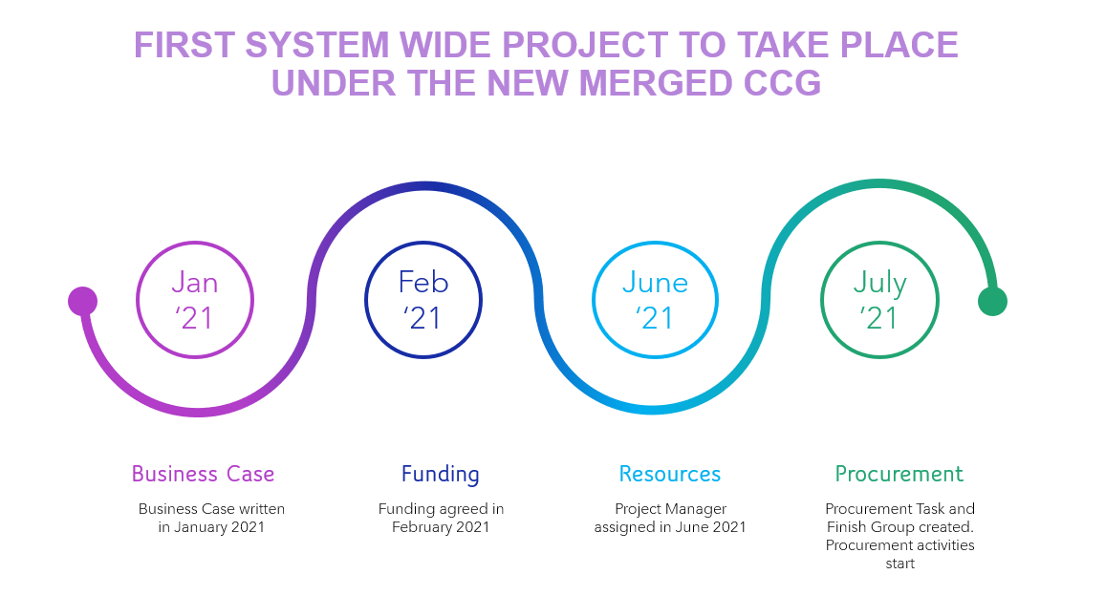
2. Project background

Slide 23
3. System and stakeholders
4 CCGs
Merged
‘Black Country & West Birmingham CCG’
Cancer ICS
Skin Cancer Network
Cancer Leads
224 GP practices
4 acute trusts
5 main sites + 1 on the border

Slide 24
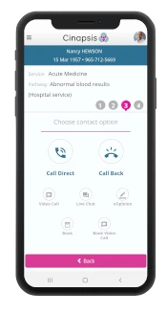
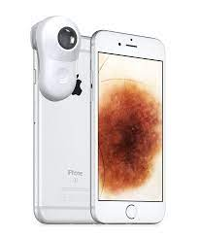
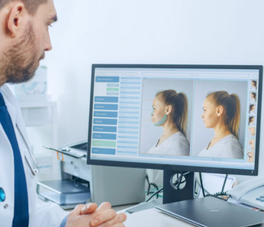
4. Teledermatology model
Primarily as a triage system, within secondary care.
Benign lesion – Patient is discharged. App generates a PDF with the photos and outcome that is posted to the patient, uploaded electronically to the GP record and uploaded electronically to the hospital record
For Surgery – The lesion is identified as malignant and suitable for direct listing for surgery. PDF generated for the patient and GP with outcome and patient information leaflet. PDF e-mailed to surgical coordinator for booking or to plastics/OMFS for
GP makes 2ww referral through Cinapsis App:
Integrated into EMIS/Systemone
Short questionnaire for relevant history
Normal and Dermoscopic photos
Automatically attaches patient history and medications
Secondary care consultant triages the case:
On the cloud and can be accessed from work or home
Specified DCC sessions to do this work in accordance with BAD guidance of a Telederm case taking 8 to 10 minutes
No dictation or other input is required
Clinic – The patient requires review in clinic. PDF is generated and sent to the patient, GP and hospital record. PDF is e-mailed to the booking team for an appointment

Slide 25
5. Stage 1: procurement stage
Getting the right people involved
Co-ordination
Subject matter experts
Dermatology panel
Teledermatology Project manager
IT operations director
Digital & Procurement Support
Transactional procurement manager
Senior transactional procurement manager
GP leads
Acute leads
CCG clinical lead
Business managers
Administration leads

Slide 26
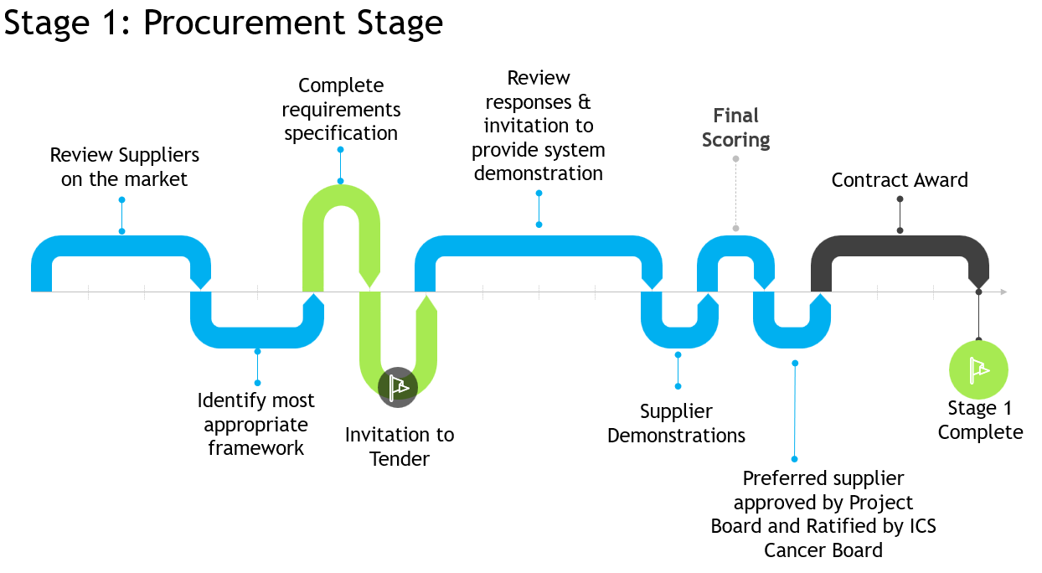

Slide 27
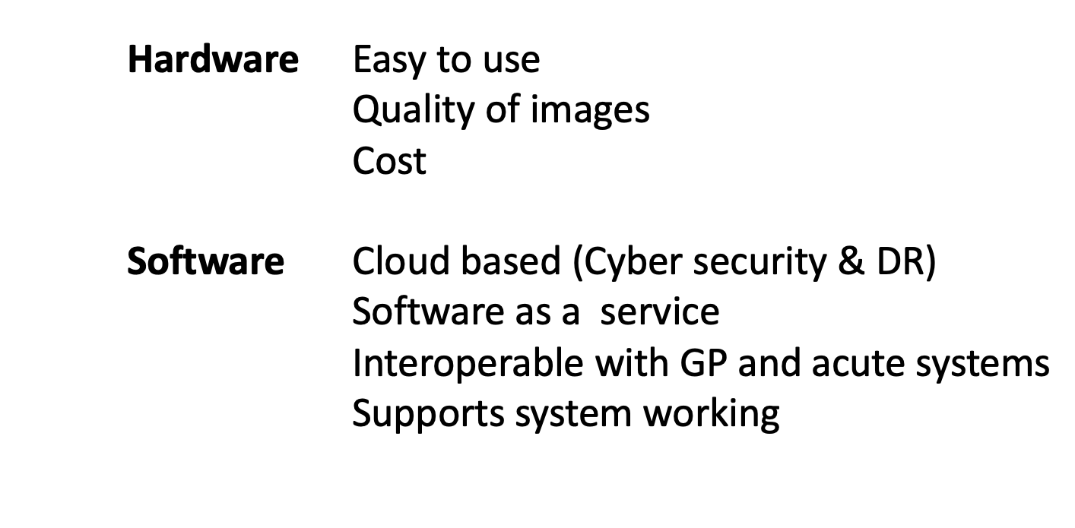
Procurement principles

Slide 28
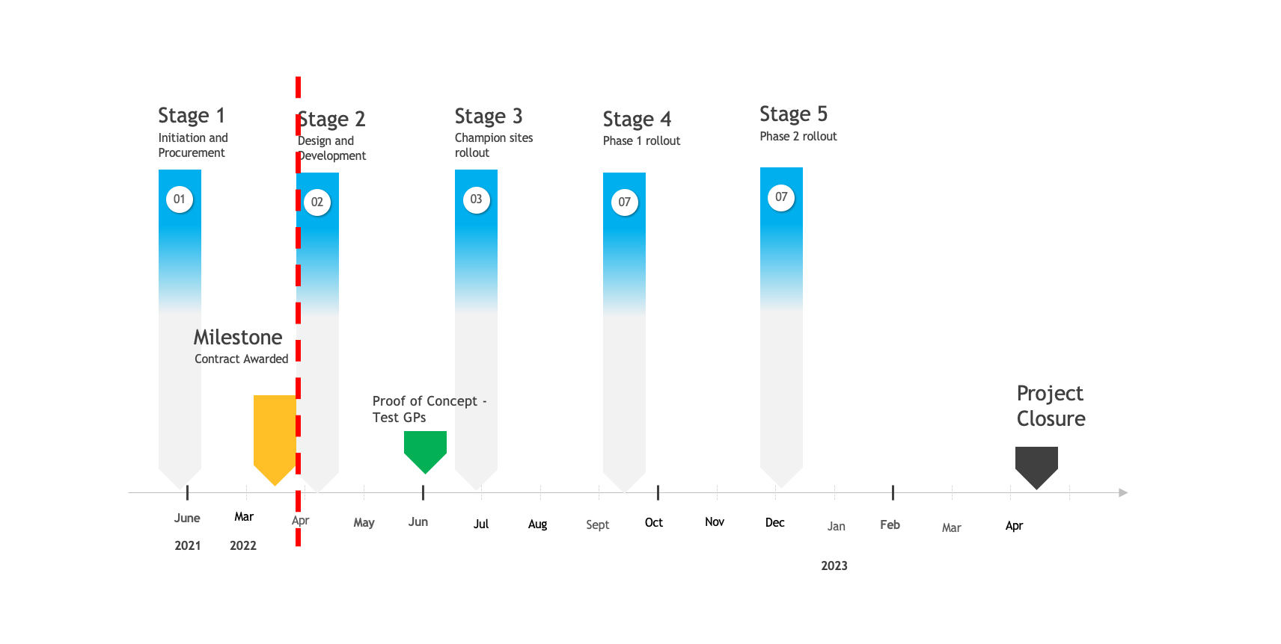
Teledermatology - next steps

Slide 29
Thank you!
Comments and questions please
Lisa.janiec@nhs.net
Mobile: 07783 821547

Slide 30
Successful Reduction in Two Week Rule Referral Numbers Through Introduction of Community Photohub
Dr Arani Chandrakumar, consultant dermatologist & clinical lead for
dermatology (ASPH), on behalf of:
Ashford & St Peter’s NHS Trust (ASPH)
Surrey Heartlands Clinical Commissioning Group (SH CCG)
North West Surrey Integrated Care Services (NICS)

Slide 31
Overview
Introduction – challenges faced by Trust and CCG
Objectives of the pilot project
Implementation of the photohub – digital platforms used
Initial results of the pilot
Barriers overcome during implementation
Summary with future developments for sustainability of service

Slide 32
Introduction
Ashford & St Peter’s NHS Trust
North West Surrey 361,265
Since 2018, includes Guildford & Waverley 231,250 (managed by ASPH, run by a separate dermatology department)
Yearly increase in Two-week Rule (TWR) referrals for skin cancer
104 TWR referrals per week
16% increase in referrals from 2019-2020 to 2021-2022
No significant change in number of substantive staff up to 2021

Slide 33
TWR referrals over the years
Summary: TWR numbers have over doubled in 4 years without a significant increase in substantive staffing levels.
Quality of referrals has remained the same with similar conversion rates to national levels.

Slide 34
Dermatology TWR photohub pathway
GP
Refer suspicious skin lesions as TWR
TWR clock starts
TWR Referral to ASPH
Patient to Photo Hub
Seen within 3 days
Take dermoscopic images and complete patient questionnaire
Macroscopic & dermoscopic (polarised & non-polarised images) taken by HCA
Photohub attach images and proforma to TWR e-RS referral
ASPH Triage
Triaged by consultant on ErS within 48 hours
Non-TWR
TWR
DNA
Book TWR with Dermatology/Maxillofacial/ ENT
Book routine skin lesion clinic
Discharge back to GP (Benign) with written reason

Slide 35
Notes:
The dermatology TWR referral form has been modified to include 2 additional questions:
Allow downgrade of TWR referral (reason required if the response is ‘No’). If the patient does not attend the Photohub they will be seen in a face to face TWR clinic.
Send to Photohub

Slide 36
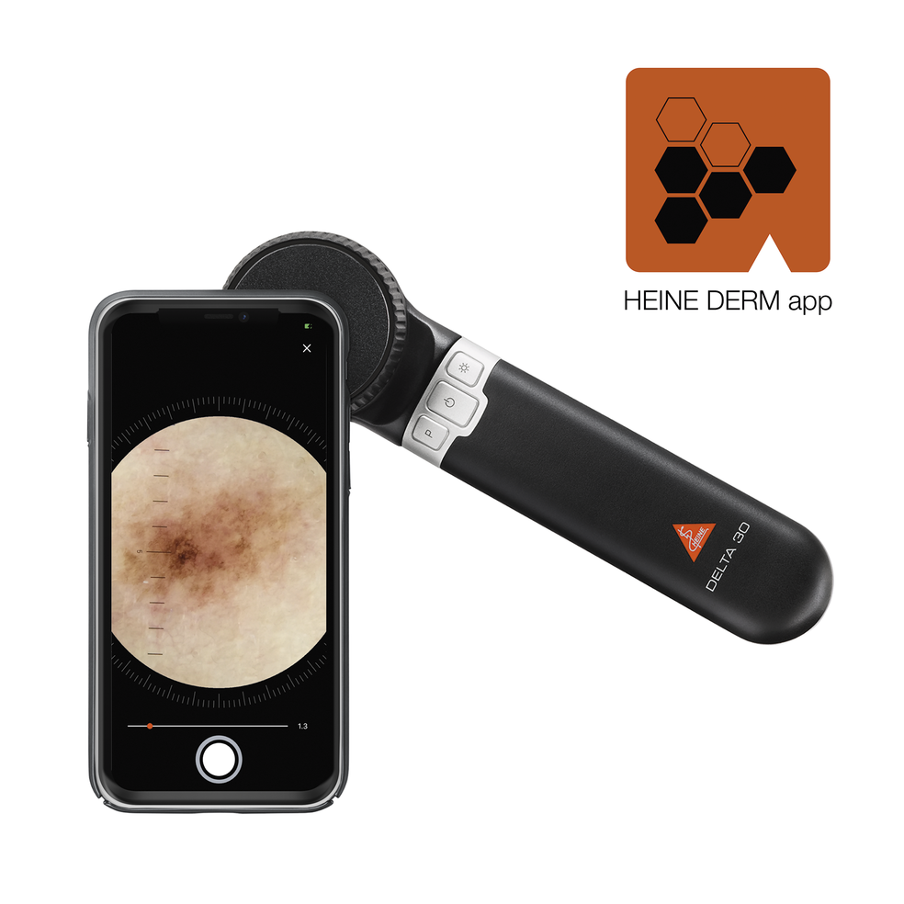
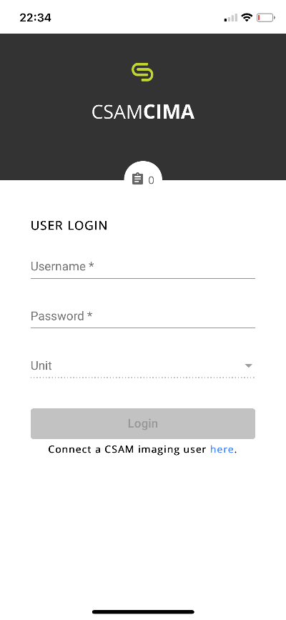
Images taken using CIMA app – images can be directly accessible from PICSARA imaging software on Trust computers.
High quality PICSARA images uploaded to ErS TWR referral for Consultant triage.

Slide 37
SASSE dermatology photohub pilot
Start date: Monday 7 March 2022
Inclusion criteria
Patient registered to a SASSE PCN practice
Patient over age 18
Patient consent to Photo hub referral
Exclusion criteria
Patients with genital skin lesion or skin lesions in a ‘sensitive’ area
Patients with significant mobility issues
Age <18 years
Patient declines to participate

Slide 40
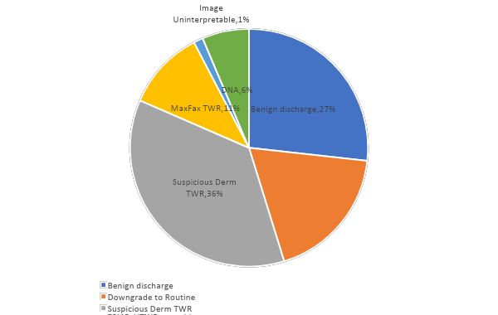
Dermatology photohub triage outcomes
Data from 7 March - 14 April 2022
TWR referrals in SASSE area reduced by 64% (DNAs will require TWR appt therefore 58% drop in TWR appts)
27% of patients referred as TWR in SASSE not requiring any hospital appt
Number of patients through photohub to date: 160

Slide 41
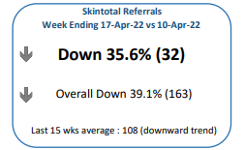
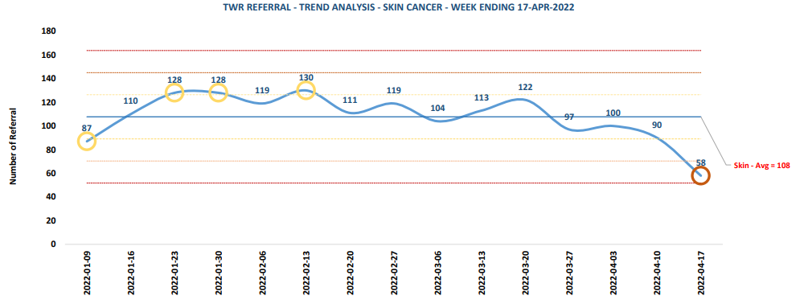
TWR referral trends
These figures include North West Surrey and Guildford & Waverley CCGs

Slide 42
Barriers to implementation
Potential risk to photo incorrect lesion
Ask GP to mark the correct lesion and send photo/ patient to photo marked lesion
Robust training for HCA on checklist and protocol
Teams chat forum for direct feedback between HCA and clinician
Time for consultant to triage images – offset against reduced TWR numbers
Administrative burden of processing photohub outcomes

Slide 43
Summary
Successful safe implementation of a TWR triage photohub demonstrating over 50% reduction in TWR referrals
Plan to roll out to whole catchment area
?Future adoption of Artificial Intelligence to triage photohub images freeing up consultant time to see more patients

Slide 44
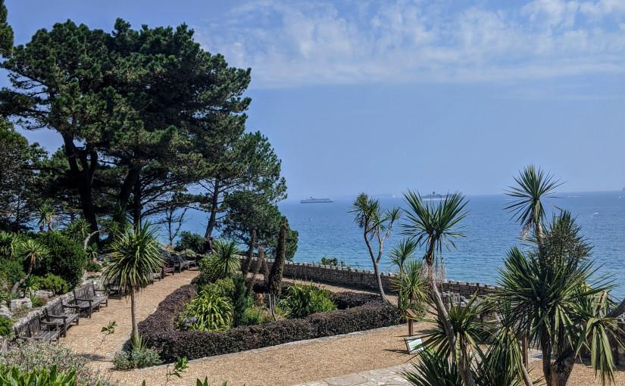
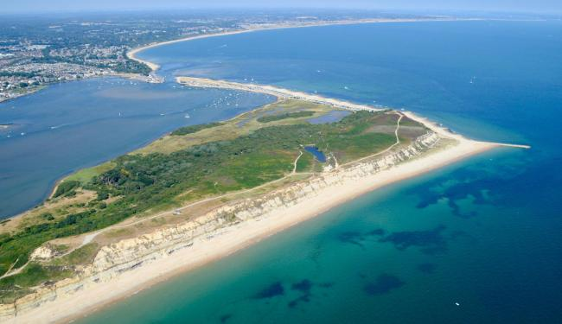
Advice & Guidance in UHD dermatology
Dr Suzannah August, consultant dermatologist
Advice and guidance in UHD Dermatology Dr Suzannah August May 2022

Slide 45
Introduction
University Hospitals Dorset (UHD) Dermatology: merger of Bournemouth and Poole hospitals in 2021
Christchurch and Poole dermatology departments now UHD Dermatology
Challenges
Lack of consultants (4.6 FTE for 700,000 patients), historically <4FTE
Increasingly high burden of skin cancer in Dorset (150 2ww referrals/week)
Impact on routine referrals (100/week)
Demand outstrips capacity – further backlog created by pandemic
Christchurch stopped receiving routine referrals in 2019

Slide 46
Switch to Advice & Guidance
Advice and guidance service offered to GPs since 2017 (via eRS)
All non-2ww referrals switched to advice and guidance pathway in October 2021
A+G pathway chosen over RAS - enables interim clinical advice for patients waiting for appointment
Change in service achieved with support from Dorset CCG, local GPs, consultants, hospital management team and NHS digital funding
GPs asked to send all referrals with images

Slide 47
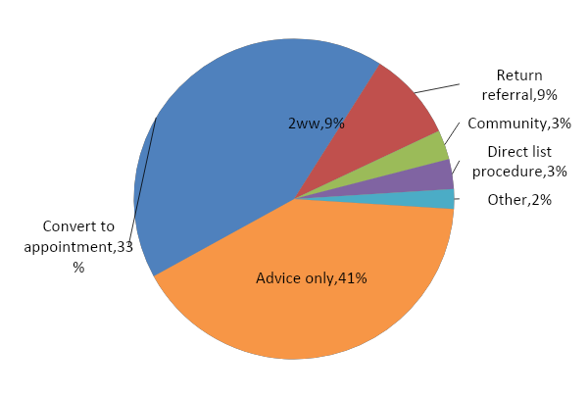
A&G outcomes - Feb/Mar 2022 (571 patients)
Notes:
Comments : bConversion to appointments 3 switching this 26% Sue a modest increase but not as much as we were expecting
bA quarter of patients converted to appointment also received interim advice
bOnly small numbers of patients being directly list of procedures–bBarriers to overcome first.
bPatients recommended to community or 2 week wait service currently require GP to make new referral, we are not working to change this so that referrals can be directly converted.

Slide 48
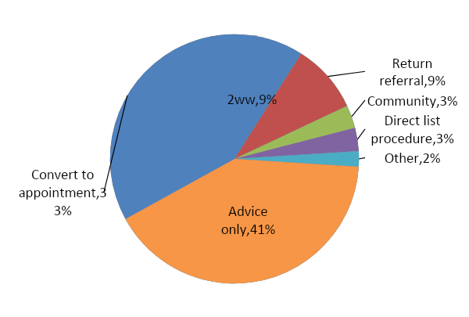
A&G outcomes
Time to respond:
All cases: mean 8.5 days (0 to 21 days)
Urgent cases: mean 3.3 days (0 to 8 days)
30% cases marked as urgent
Referrals returned:
No image - 40%
Image out of focus/ thumbnail – 40%
Quality of referrals improved over last 6 months:
eConsult documents reduced by 60%
Returned referrals reduced from 12% to 9%

Slide 49
A&G outcomes
Conversion to clinic appointments was 23% before switch
25% patients converted appointment also received interim advice
Only a small number of patients were directly listed of procedures
GP required to make second referral if community clinic or 2ww recommended

Slide 50
How?
‘Hot week’ – routine clinical work cancelled and backlog of A&G cases cleared
Existing patients waiting for OP appointments validated by SpR phone calls (approx 25% discharged or started on treatment, 10% upgraded to urgent)
Communication with GPs
Information via CCG and GP networks
Formal education sessions
Feedback via A&G responses

Slide 51
Challenges
eRS system, issues with functionality:
Integration with hospital patient record
Integration with hospital administration
Visible data on activity or outcomes
Visibility of cases between clinicians
Temporary solution – shared MS Teams spreadsheet

Slide 52
Teams spreadsheet

Slide 53
Teams spreadsheet
Cases for teaching flagged
Admin team can action urgent appointments promptly
Issues with referrals identified / fed back

Slide 54
Challenges
Lack of usability of eRS platform
Short term
Dragon voice recognition software
Shared templates – standard letters, clinical information etc
Additional administrative staff
Clinicians doing additional sessions to cover workload (150 cases per week)
A&G ‘ urgent case hub’ run with trainees supervised by a consultant
Medium term
Local IT team developing an in-house platform to integrate eRS with hospital systems
New consultants trained or recruited 2022/23

Slide 55
Conclusions
A&G is enabling a more streamlined dermatology outpatient service
Excellent training opportunities for dermatology trainees and GPs
The future
Obtain formal feedback from GPs on the service
Track demand and capacity to ensure adequate resources and clinical time
Develop education in teledermatology for clinicians
Integrate platform with hospital systems
Increase direct listing of patients for procedures

Slide 56
Thank you!
Questions?
A recording of the webinar is available here: https://badannualmeeting.co.uk/future_nhs_webinar/

